Slide 1
Challenges Part 1
BIO 4990/6990
Dr. Megan Smith
April 22, 2024

Slide 2
Challenges in Machine Learning
Quality of Training Data
Transfer Learning
Domain Shifts
Ethical Challenges
Interpretability and the Black Box
Hyperparameter Optimization
Overfitting

Slide 3
Quality of Training Data
Accuracy: minimal errors
Completeness: missing data should be minimal, and, ideally, random.
Consistency: data should have been collected in a consistent manner
Representative: data should represent the population being modeled fully
Garbage In- Garbage Out!

Slide 4
Quality of Training Data: Data Augmentation
Data augmentation is a technique used to artificially increase the size and diversity of a dataset by creating modified or augmented versions of existing data points.
Often used in image processing.
Original data are copied, transformed, and entered into the training data again.
Transformation techniques include rotation, flipping, scaling, shifting, cropping and adding noise.

Slide 5
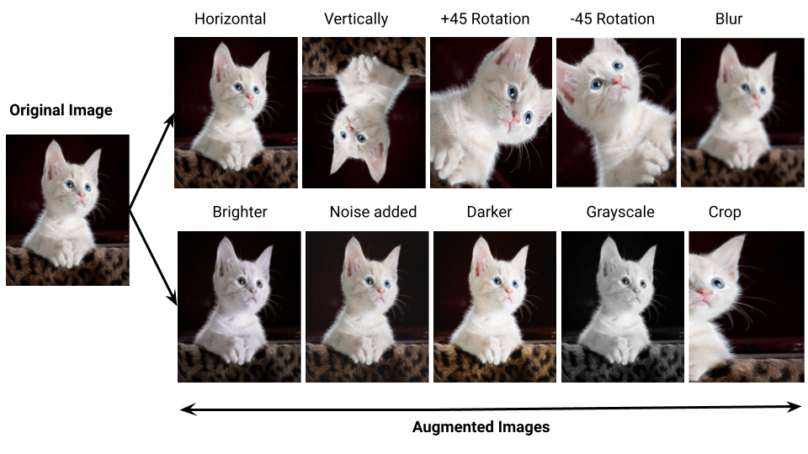
Quality of Training Data: Data Augmentation

Slide 6
Quality of Training Data: Data Augmentation
Benefits of Data Augmentation:
Increases the diversity of the training data.
Improves network generalization.
Results in networks that are more robust to noise.
Can be used to reduce risks of biases due to imbalanced classes.
Can be used in cases where training data is limited.
Examples of Data Augmentation in Biology
Adding noise to mimic sequencing error or other measurement errors.
Image transformations for CNNs.

Slide 7
Challenges in Machine Learning
Quality of Training Data
Transfer Learning
Domain Shifts
Ethical Challenges
Interpretability and the Black Box
Hyperparameter Optimization
Overfitting

Slide 8
Transfer Learning
In transfer learning, a network trained for one task is applied to a second, related task.
This allows for improved performance when modeling the second task.
Transfer learning is useful when the features extracted for the first task are general enough to be useful for the new task.
Essentially, the scope of possible models is narrowed by using information from the related task.

Slide 9
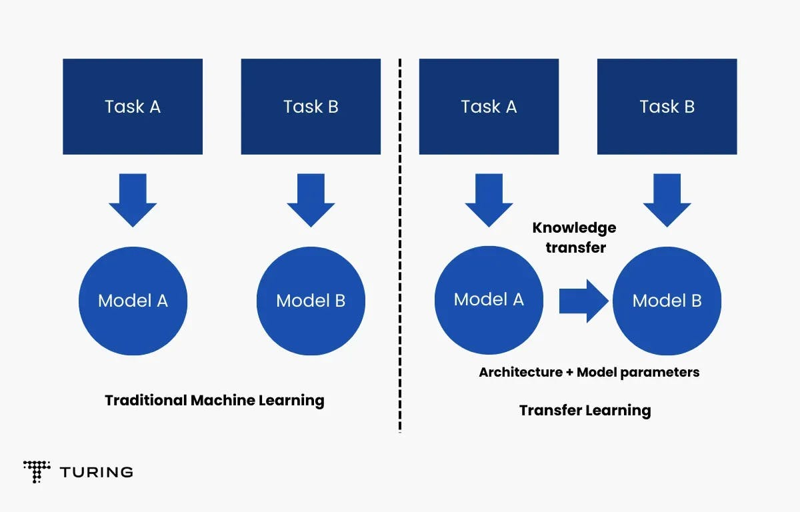
Transfer Learning

Slide 10
Approaches for Transfer Learning
Develop model approach
Select source task
Train source model
Re-use model as starting point for target task
Tune model for the target task (i.e., train it more!)
Pre-trained model approach
Select source model
Re-use model as starting point for target task
Tune model for the target task

Slide 11
Approaches for Transfer Learning
Develop model approach example: background selection
Goal: Infer migration between populations
Challenge: Background selection can mislead such inferences, but is expensive to simulate
Approach:
Train a network to detect migration using data simulated under a neutral model.
Tune the network using a smaller amount of data simulated with selection.
Apply the network!

Slide 12
Approaches for Transfer Learning
Pre-trained model approach example: squirrel detection
Goal: Greg wants to detect squirrels eating from his bird feeder.
Challenge: It would take a lot of time for Greg to label many photos from his back yard and use those to train a network.
Approach:
Use the YOLO model, a pretrained general image classifier.
Tune the YOLO model using some photos from Greg’s backyard
Use the YOLO model to identify the things visiting Greg’s birdfeeder.

Slide 13
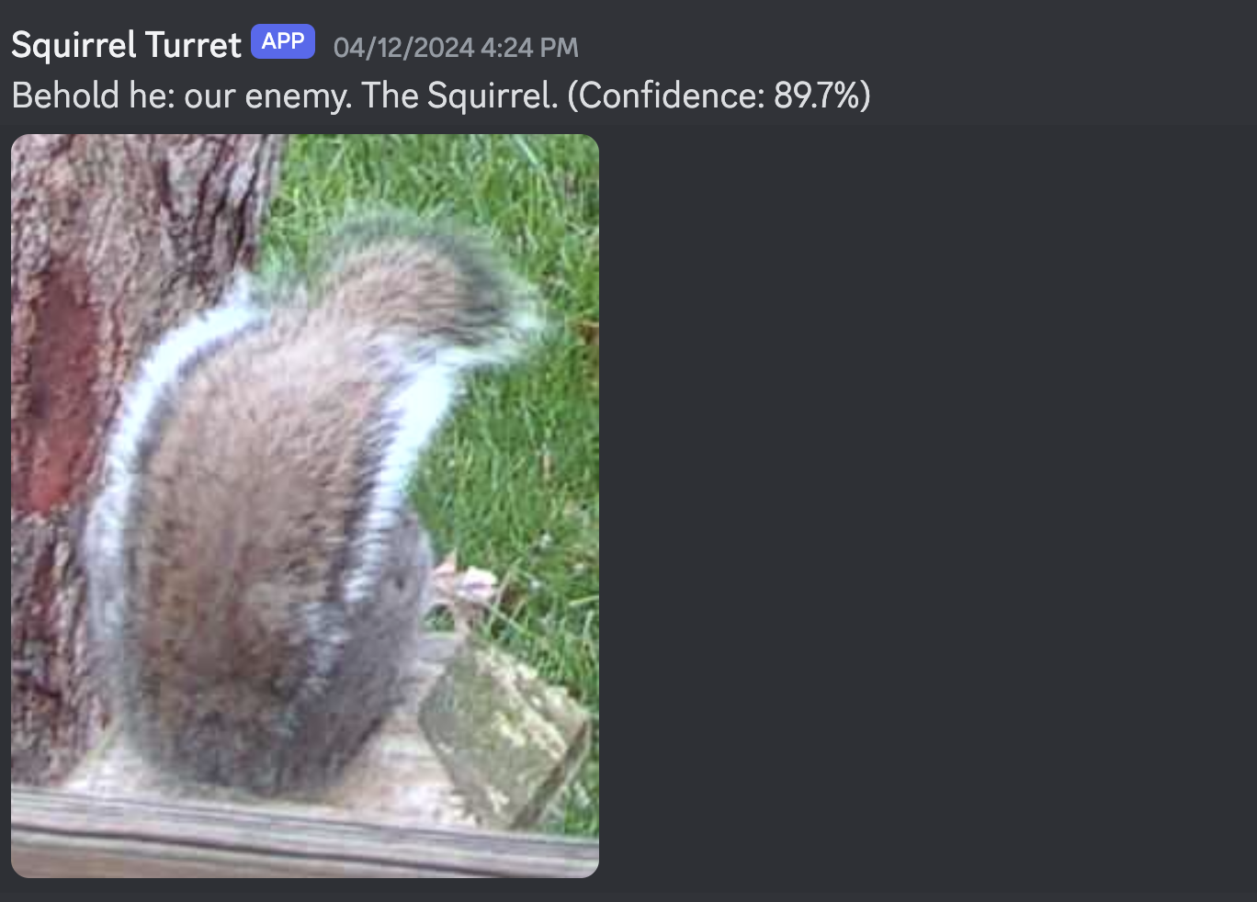
Approaches for Transfer Learning

Slide 14
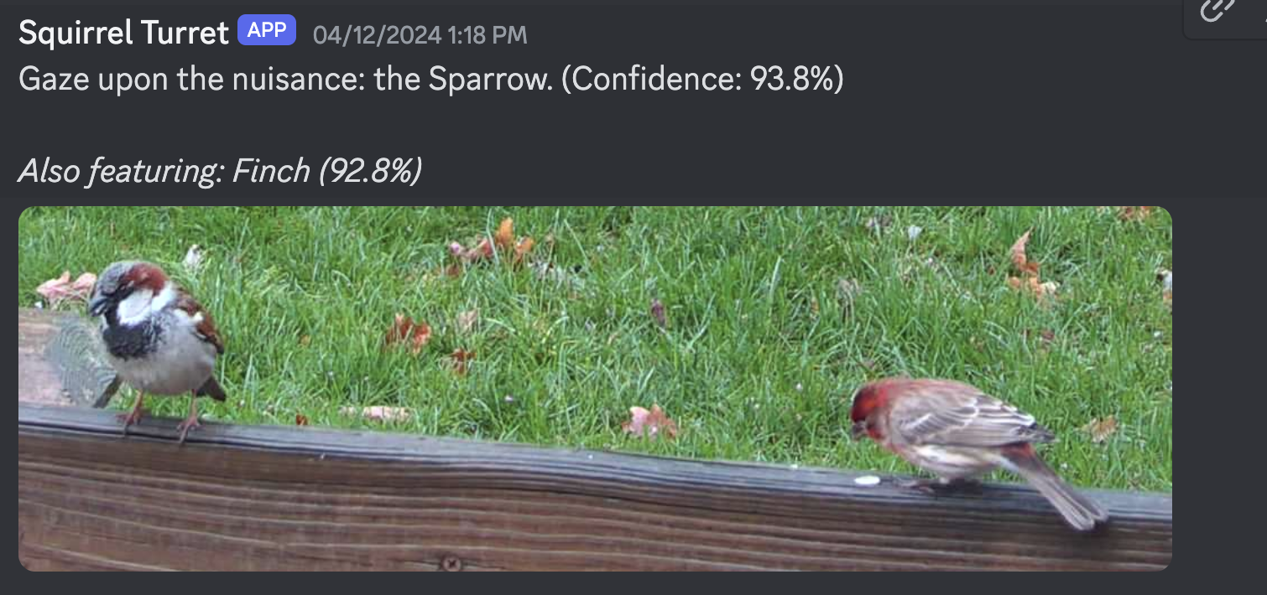
Approaches for Transfer Learning

Slide 15
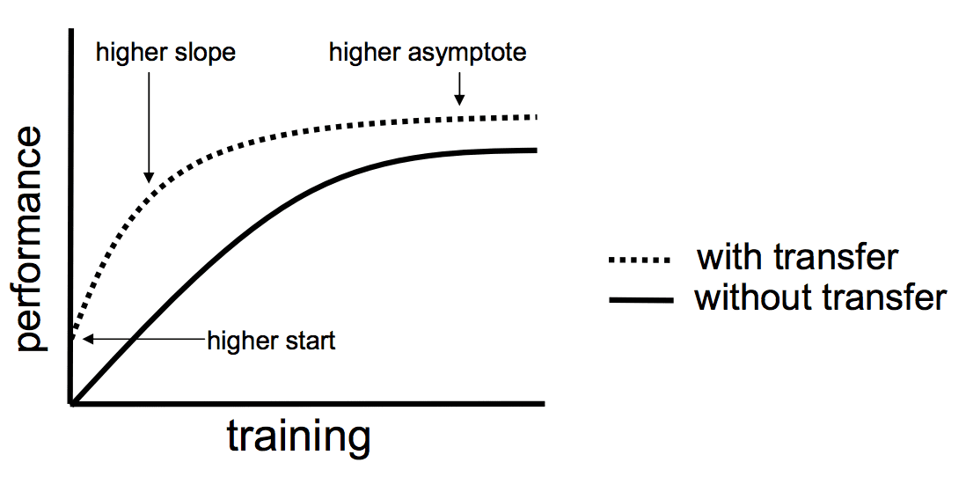
When to use transfer learning
Higher start: the initial skill is higher than it would be otherwise
Higher slope: the rate of improvement is higher than it would be otherwise
Higher asymptote: the final skill is higher than it would be otherwise.

Slide 16
When to use transfer learning
Limited labeled data in the target domain.
Related tasks between the target and source domains.
In cases where there is a high risk of overfitting.
Limited access to computational resources.

Slide 17
Choices to make when transfer learning
Should you freeze some layers when training?
How much tuning should you do?
How much data do you need from the target domain?

Slide 18
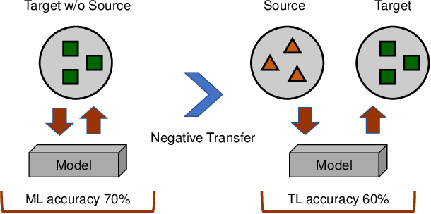
Challenges in Transfer Learning
Negative transfer is possible!
Negative transfer refers to a scenario in which using a pre-trained model results in worse performance than starting from scratch!

Slide 19
Challenges in Machine Learning
Quality of Training Data
Transfer Learning
Domain Shifts
Ethical Challenges
Interpretability and the Black Box
Hyperparameter Optimization
Overfitting

Slide 20
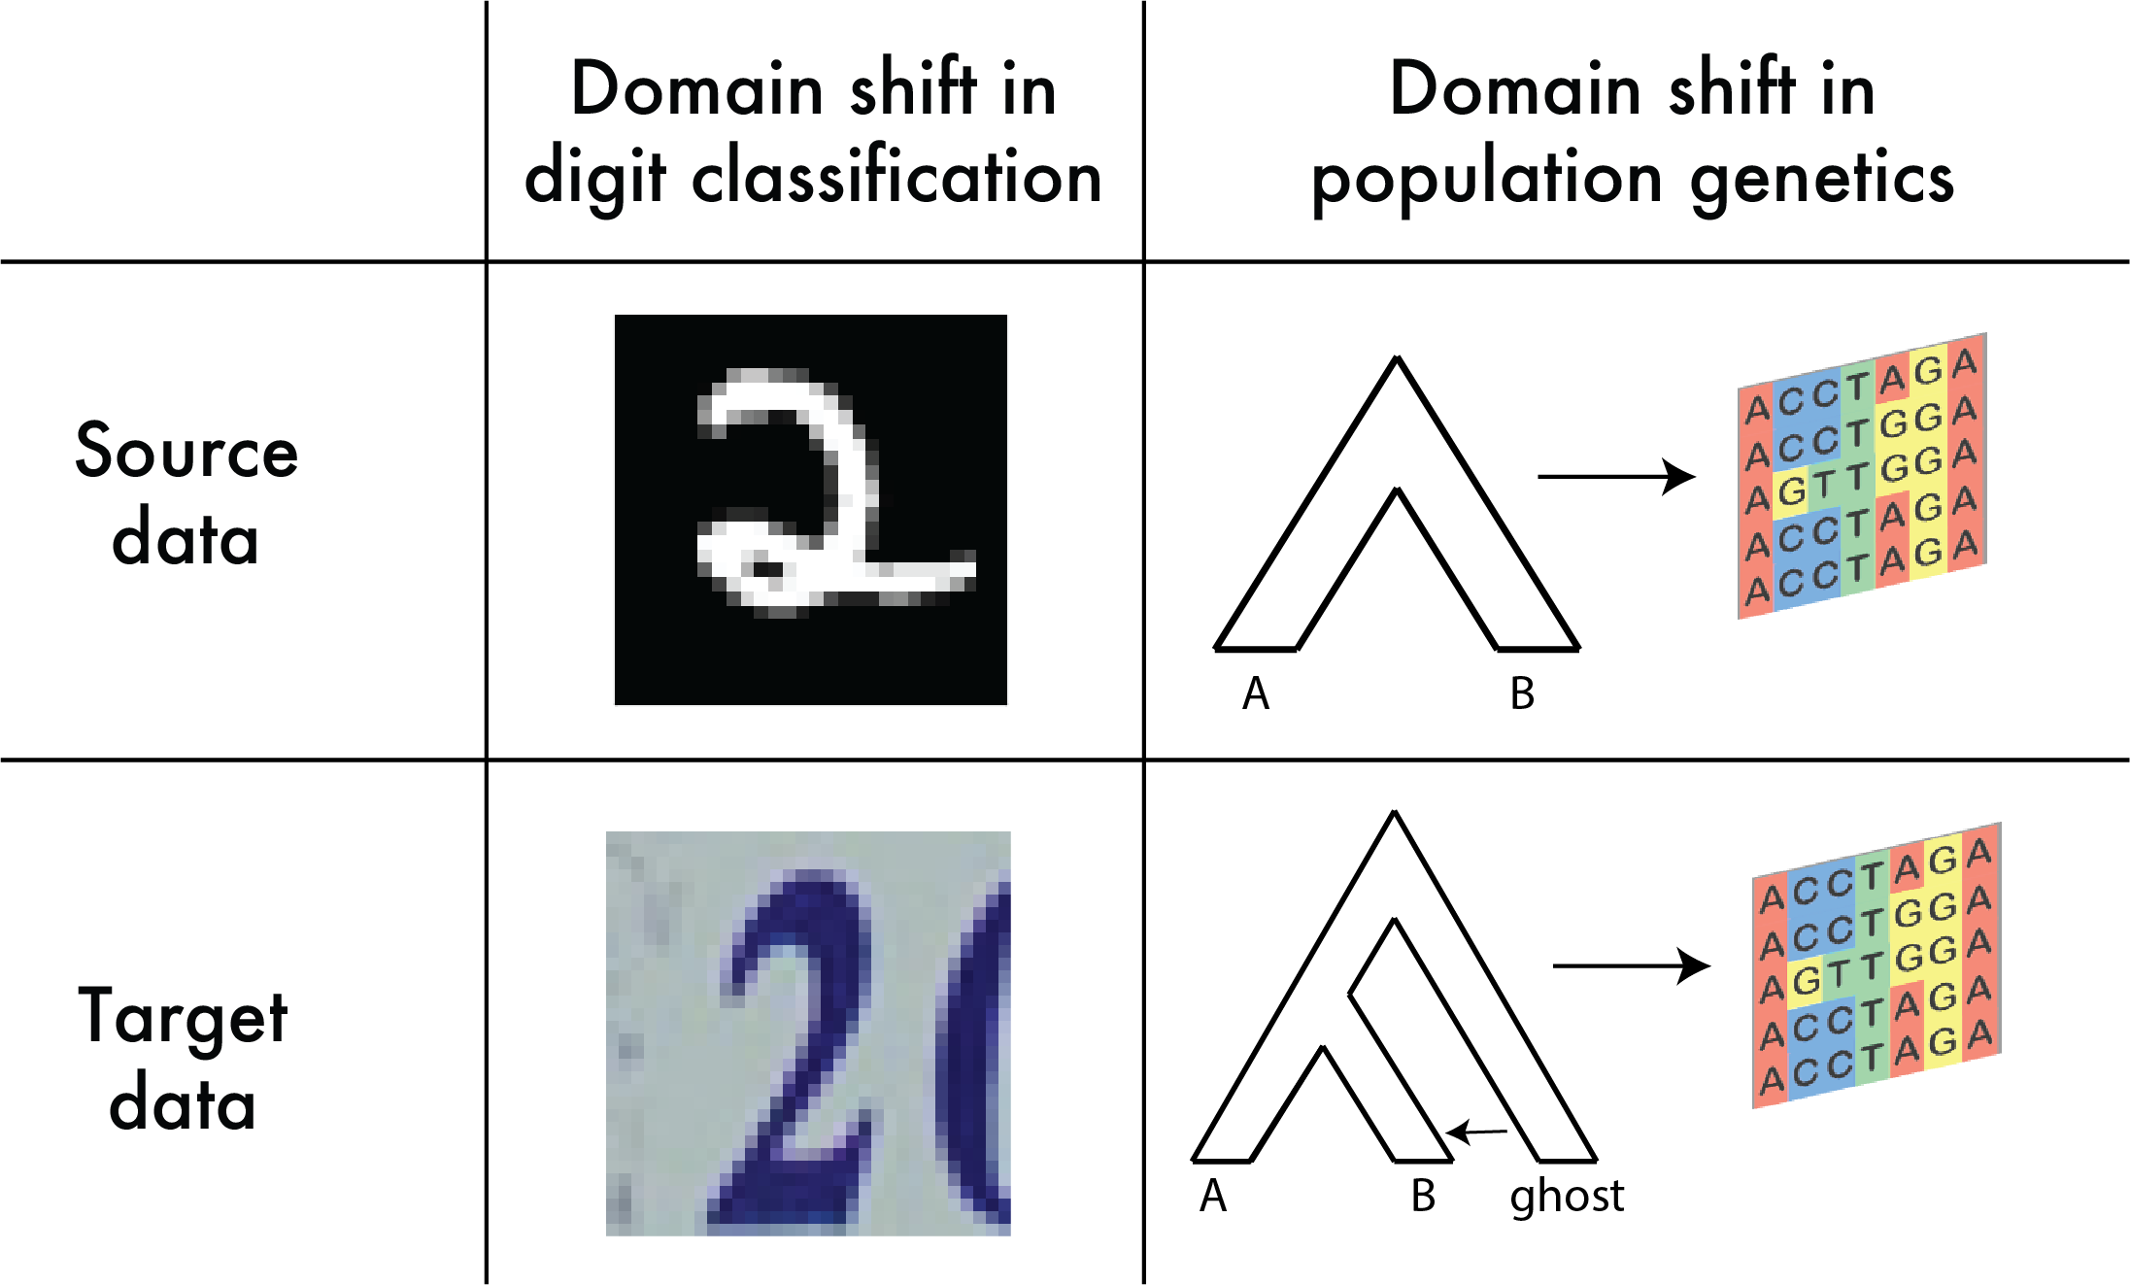
Domain Shifts
Domain shifts occur when the distributions from which source and target data are drawn differ.

Slide 21
Domain Shifts
Domain shifts can lead to poor performance in the target domain.
Domain shifts are likely to be prevalent in biological applications.
Examples:
Train a network to predict disease outcomes using data from a single hospital and apply it across the US.
Train a network on data simulated under one model, and apply it to empirical data where other processes have been important.
Train a network on images produced by one machine, and apply it to images from another machine.
Train a network on protein functions inferred from mammalian systems, and use it to predict protein functions in slugs.

Slide 22
Domain Adaptation
Domain adaptation aims to adapt a network trained on the source distribution to a different, but related, target distribution.
Domain adaptation is a subfield of transfer learning.
Domain adaptation can be unsupervised or supervised.
Supervised domain adaptation: labeled data is available from both the source and target domains.
Unsupervised domain adaptation: labeled data is not available from the target domain.

Slide 23
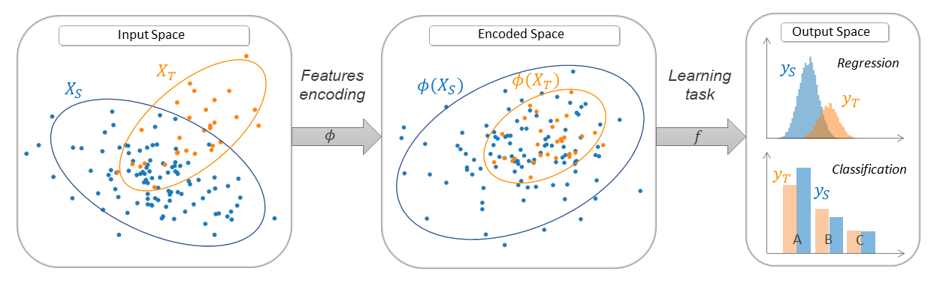
Types of Domain Adaptation
Feature-based
Extract features that are similar between the target and source domain.

Slide 24
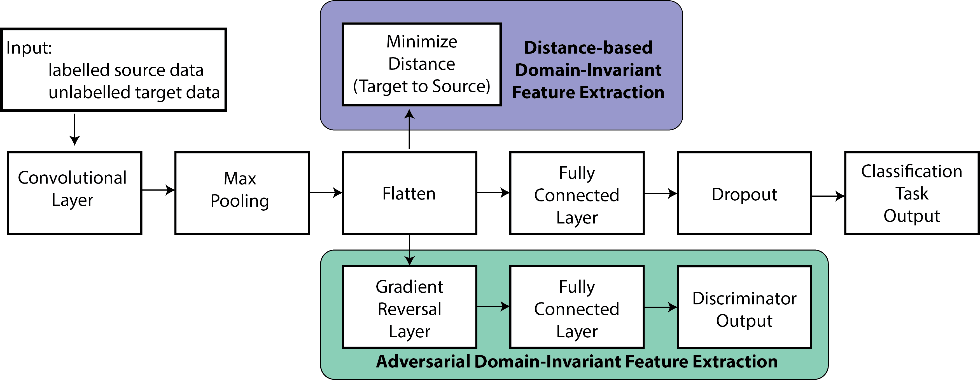
Domain Adaptation: Feature-based

Slide 25
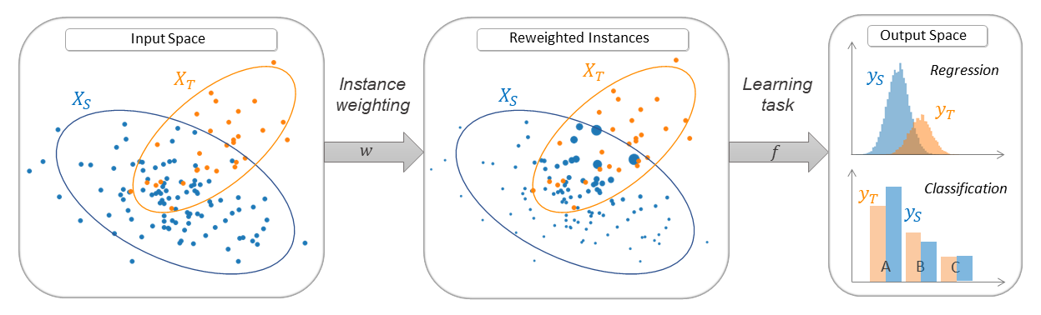
Types of Domain Adaptation
Instance-based
Reweight training data to correct the difference between source and target distributions

Slide 26
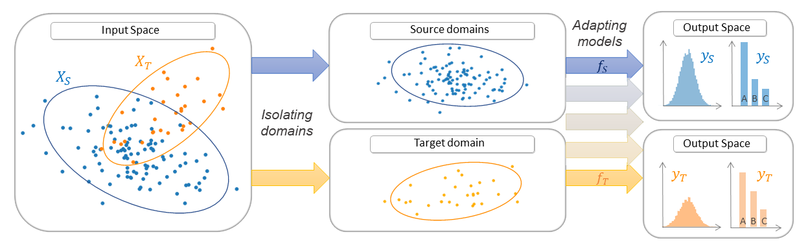
Types of Domain Adaptation
Parameter-based
The parameters of a pre-trained model built with the source data are adapted to the target domain by training on the target data.

Slide 27
When should we use domain adaptation?
Anytime we suspect a shift in domains, but we cannot feasibly train a classifier in the target domain!

Slide 28
Challenges in Machine Learning
Quality of Training Data
Transfer Learning
Domain Shifts
Ethical Challenges
Interpretability and the Black Box
Hyperparameter Optimization
Overfitting

Slide 29
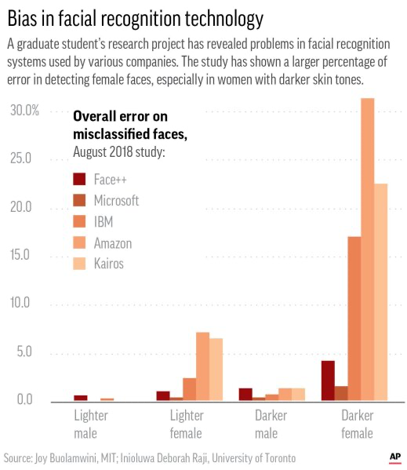
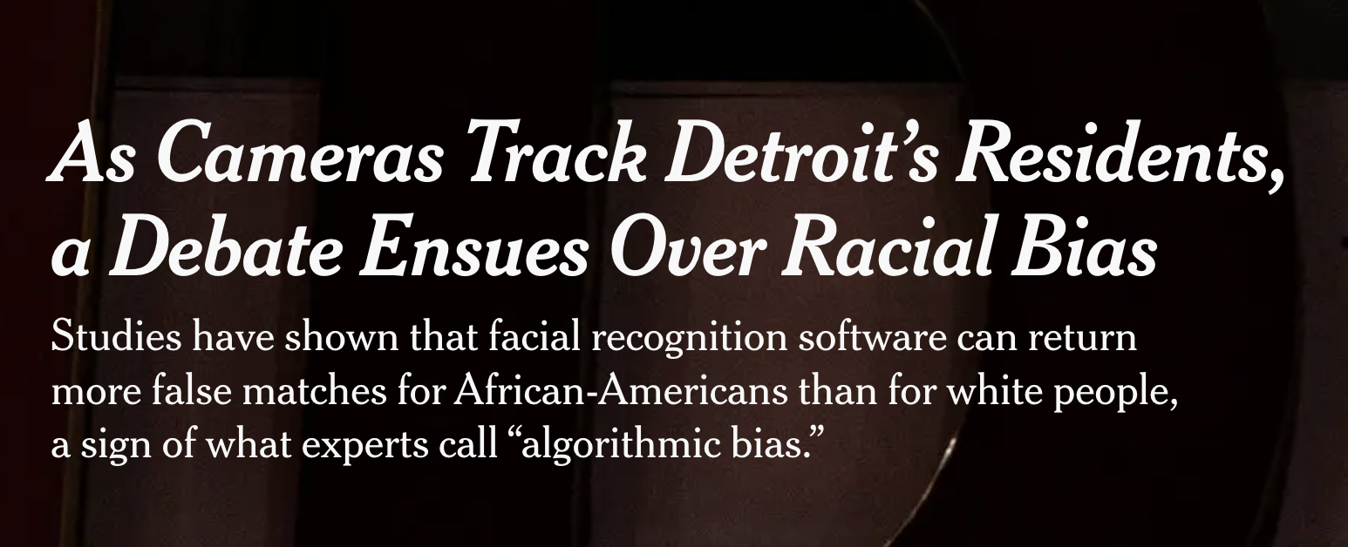
Ethical Challenges: Bias
Algorithmic biases can arise due to biases present in the training data.

Slide 30
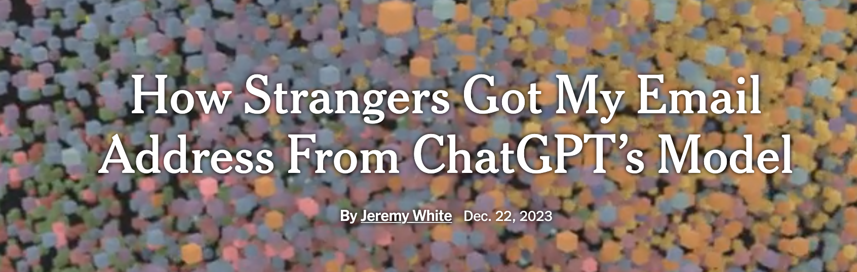
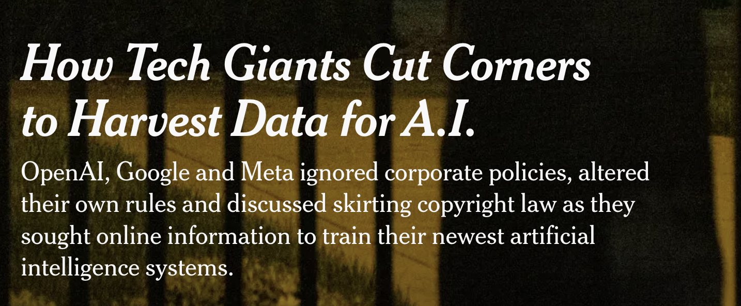
Ethical Challenges: Privacy and Security

Slide 31
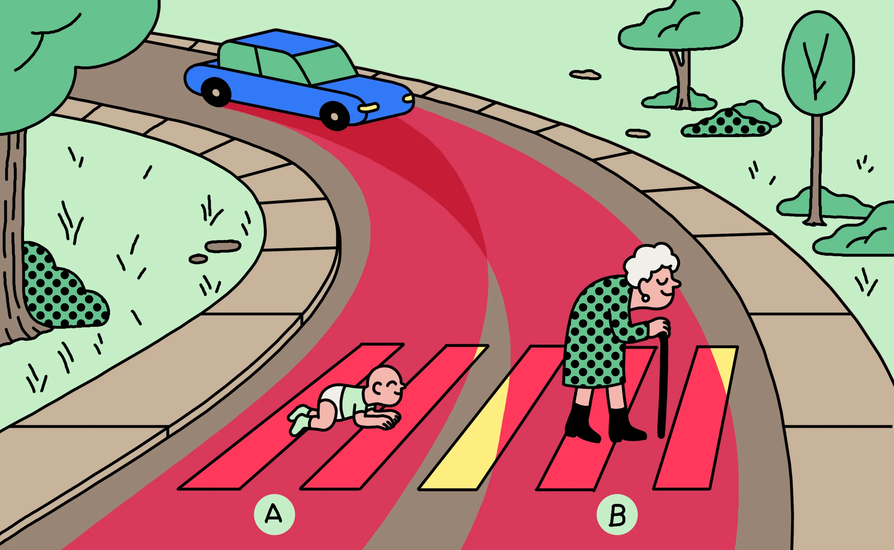
Ethical Challenges: Decision Making

Slide 32
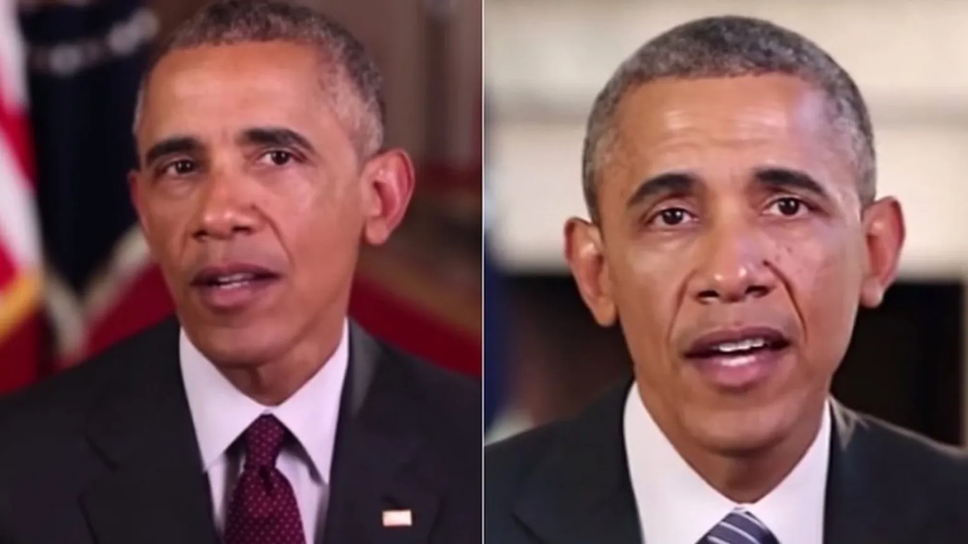
Ethical Challenges: Deep Fakes
NYT Quiz

Slide 33
Challenges in Machine Learning
Quality of Training Data
Transfer Learning
Domain Shifts
Ethical Challenges
Interpretability and the Black Box
Hyperparameter Optimization
Overfitting

